Slide 1
BAN 502 – Module 4 Random Forests
Dr. Avinash Geda

Slide 2
Trees → Main Weakness
While intuitive → Trees often overfit
How to overcome?
Build lots of trees and allow them to “vote” on the outcome

Slide 3
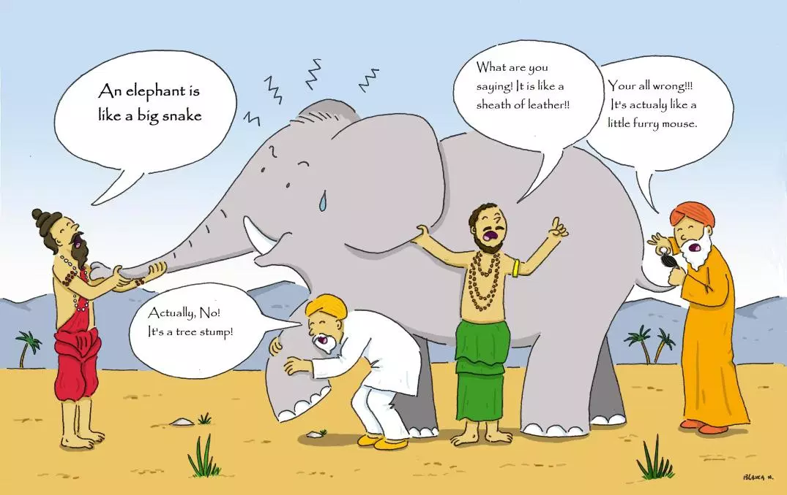
Ensembles
https://wildequus.org/2014/05/07/sufi-story-blind-men-elephant/

Slide 4
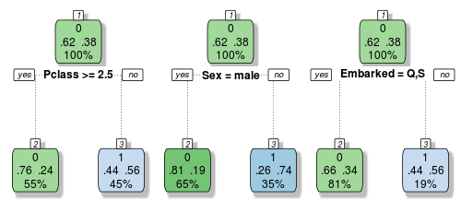
Random Forests
An ensemble of trees

Slide 5
Random Forests
Build many trees → Build as deep as possible
Use randomness so that trees are not the same
“Bagging” → Sample rows (with replacement)
Sample variables
Create trees and vote

Slide 6
Random Forests
The Good
Avoids overfitting
Can use for variable selection for other methods
Conceptually easy
The Bad
Computationally intensive

Slide 7
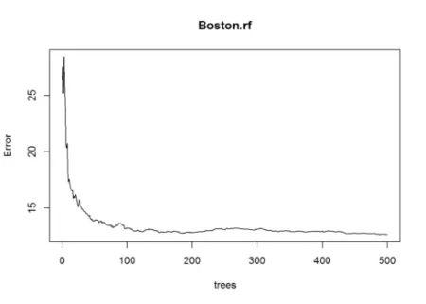
Random Forests in Software

